Slide 1
Word Spotter
Team Members:
Ritvik Agrawal (2018122005)
Kirandevraj R (2019701001)
Vivek Chandela (20171195)
Github Repo: https://github.com/Kirandevraj/Handwritten-Word-Spotting-with-Corrected-Attributes

Slide 2
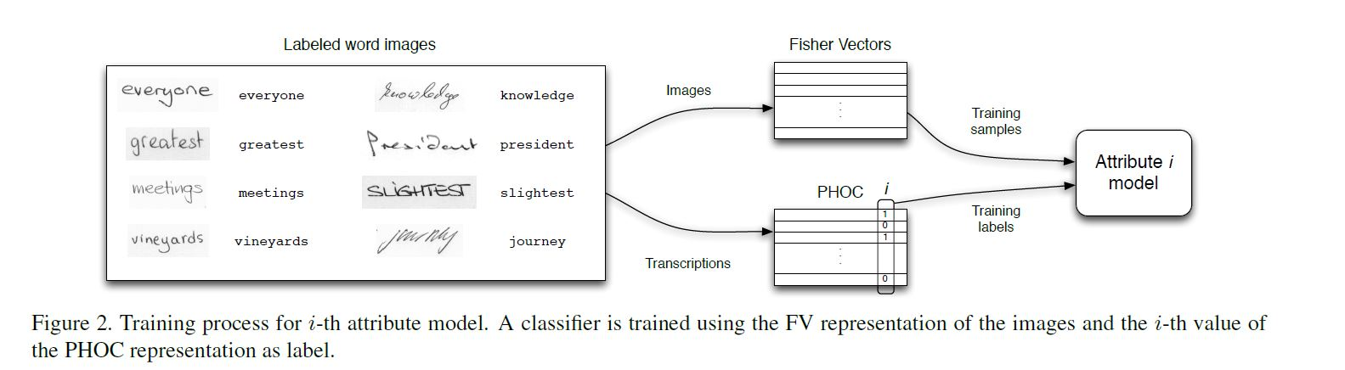
Objective
Find all instances of a given word in a large dataset with multi-writer setting
Attributes-based approach that leads to a low-dim, fixed length repr. of word images
Implement particular case of semantic content based image retrieval ( CBIR )
2 types of queries:
Query-by-example ( Image ) - Query-by-string ( Text )

Slide 3
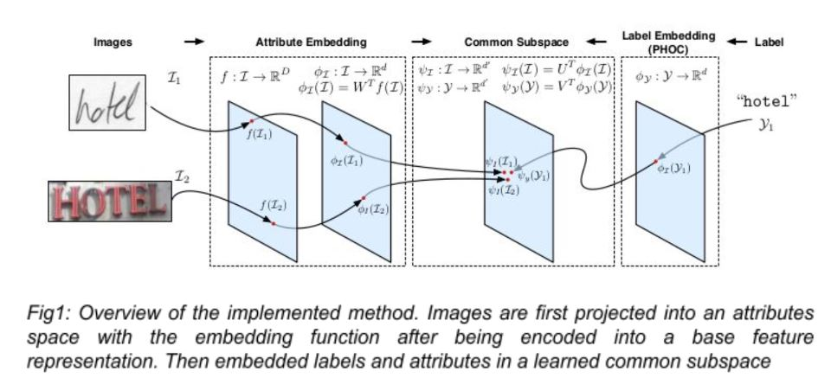
Pipeline

Slide 4
Timeline of Work Done
Extract SIFT features densely over the image using VLFeat’s vl_phow implementation.
Reduce dimension of SIFT features using PCA.
Using 16 gaussians per GMM, train GMM using SIFT features.
These features are then aggregated into an FV that considers the gradients with respect to the means and variances of the GMM generative model.
For training PHOC of an image, we use levels 2, 3 and 4 as well as 75 common bigrams at level 2, leading to 384 dimensions.

Slide 5
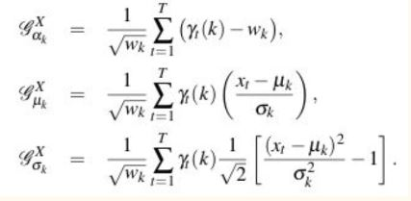
Fisher Vector
A Gaussian Mixture Model (GMM) is used to model the distribution of features (e.g. SIFT) extracted all over the image
The Fisher Vector (FV) encodes the gradients of the log-likelihood of the features under the GMM, with respect to the GMM parameters.

Slide 6
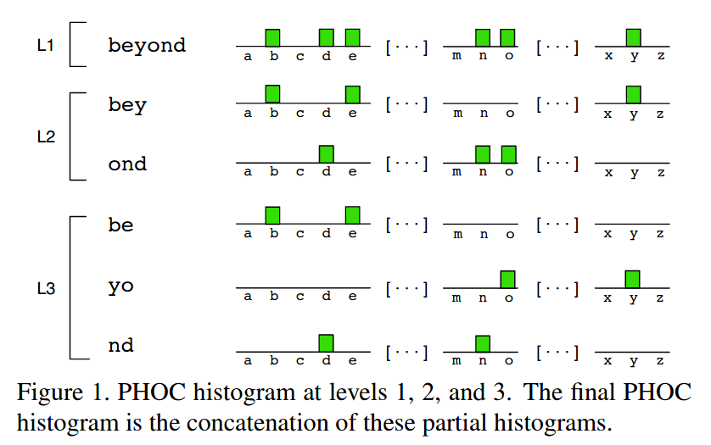
PHOC
Pyramidal Histogram of Characters:
This binary histogram encodes whether a particular character appears in the represented word or not.
E.g ‘listen’ and ‘silent’ have same L1 so we use L2 and so on
Spatial pyramid representation ensures that the information of the characters order is preserved

Slide 7
Code Implementation
WordSpotter
Images
Generate GMM
Get Features from images
Fit 16 Gaussian Models
Fisher Features
SVM
PHOC of strings
CCA
Corrected Attributes

Slide 8
Implementation Challenges
Since we’re using Dense SIFT many features were coming out to be zero which was resulting in erroneous results. Excluded such features.
High Computational power required as the dataset is huge (~1M images).
Initially used sklearn’s GMM but it had convergence issues. So used vlfeat’s implementation of GMM.
Used vlfeat’s python implementation of FV as our own implementation in python was slow.

Slide 9
Technical Challenges
Very fine-grained classes - difference of one character is a negative result
Very high intra-class variability - different writers may have completely different writing styles
Variable-length features are unsuitable due to 3 reasons:
OOV ( out of vocabulary ) not possible so, only a known, limited number of keywords can be used as queries
Computing distance between words is very slow at test time
Although they are more flexible than fixed-length sequences, they don’t leverage supervised information to learn similarities and differences between different writing styles

Slide 10

Fisher Vector and PHOC Results
The fisher vectors of all the images are calculated.
PCA is applied on them to generate attributes of 64 dimensions.
The similarity between two images on the generated attribute space is compared with cosine similarity
The results of retrieved results based on fisher vector are:
Query Results
PHOC()(“and”) = [ 1…..1…….1……..1…...1…….1……...1…...1……..1……..1….. ]
Pos: 0 29 39 52 91 107 156 195 211 318

Slide 11
Future Work
Predict/train the PHOC attributes using a SVM classifier, given the FV.
Since we have the image and string for a word, actual PHOC attributes can be found by using the string input
Using CCA (Canonical Correlation Analysis), get the projections of the predicted scores and the ground truth values
Use cosine similarity to compare the CCA learnt representations.

Slide 12
Thanks

